Slide 1

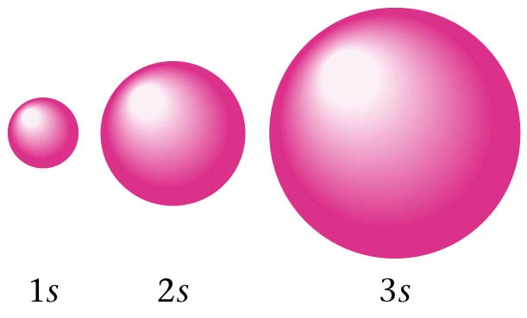
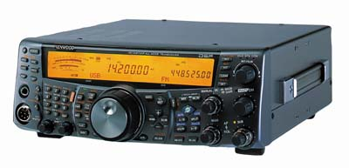
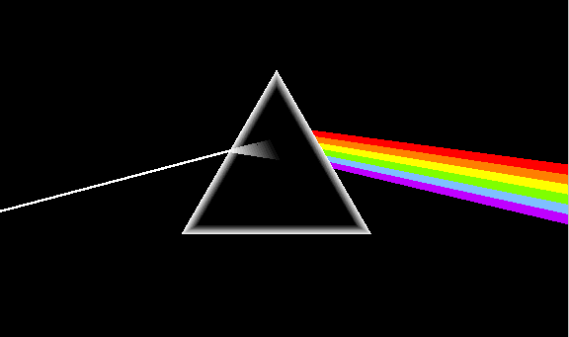
Modern Atomic Theory (a.k.a. the electron chapter!)
Chemistry 1: Chapters 5, 6, and 7
Chemistry 1 Honors: Chapter 11
SAVE PAPER AND INK!!! When you print out the notes on PowerPoint, print "Handouts" instead of "Slides" in the print setup. Also, turn off the backgrounds (Tools>Options>Print>UNcheck "Background Printing")!

Slide 2
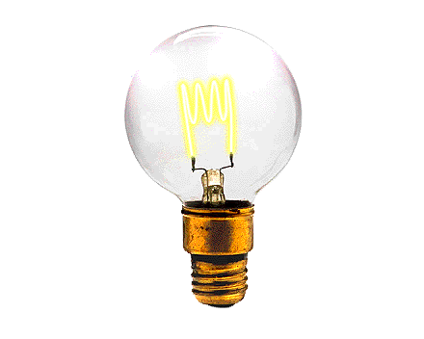
ELECTROMAGNETIC RADIATION

Slide 3
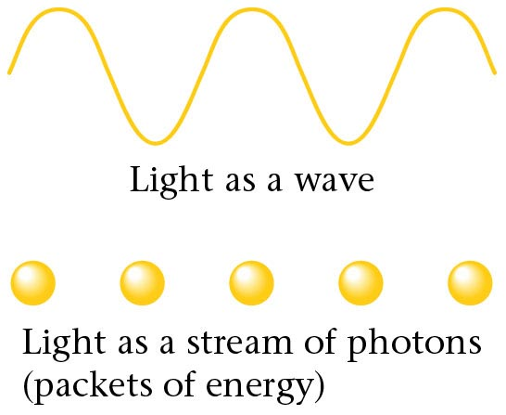
Electromagnetic radiation.

Slide 4
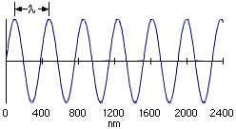
Electromagnetic Radiation
Most subatomic particles behave as PARTICLES and obey the physics of waves.

Slide 5
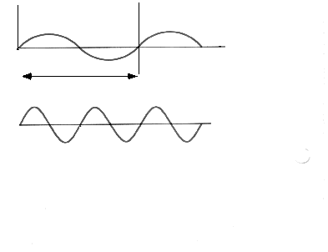
Electromagnetic Radiation
wavelength
Visible light
Amplitude
wavelength
Node
Ultaviolet radiation

Slide 6
Electromagnetic Radiation
Waves have a frequency
Use the Greek letter “nu”, ν, for frequency, and units are “cycles per sec”
All radiation: λ • ν = c where c = velocity of light = 3.00 x 10⁸ m/sec

Slide 7

Electromagnetic Spectrum
Long wavelength --> small frequency
Short wavelength --> high frequency
increasing frequency
increasing wavelength

Slide 8
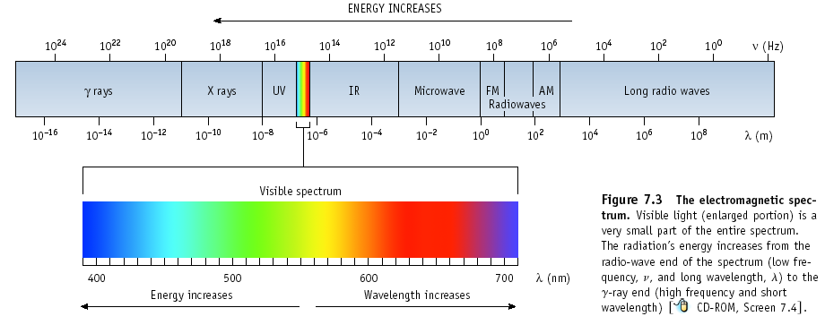
Electromagnetic Spectrum
In increasing energy, ROY G BIV

Slide 9
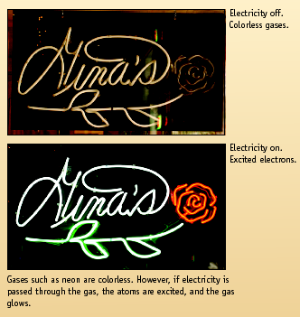



Excited Gases & Atomic Structure

Slide 10
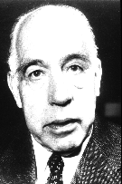
Atomic Line Emission Spectra and Niels Bohr
Bohr’s greatest contribution to science was in building a simple model of the atom. It was based on an understanding of the LINE EMISSION SPECTRA of excited atoms.
Problem is that the model only works for H
Niels Bohr
(1885-1962)

Slide 11
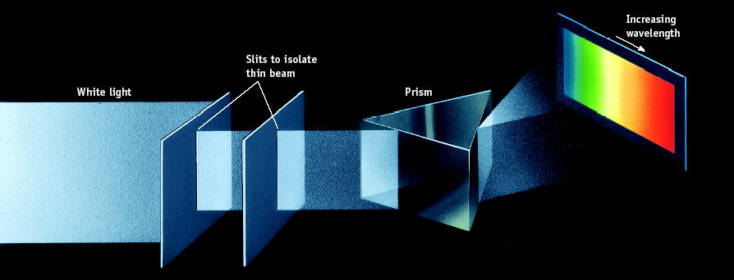
Spectrum of White Light

Slide 12
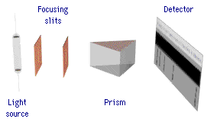
Line Emission Spectra of Excited Atoms
Excited atoms emit light of only certain wavelengths
The wavelengths of emitted light depend on the element.

Slide 13
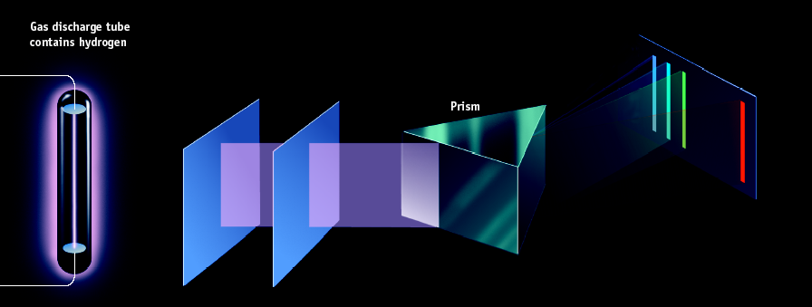
Spectrum of Excited Hydrogen Gas

Slide 14
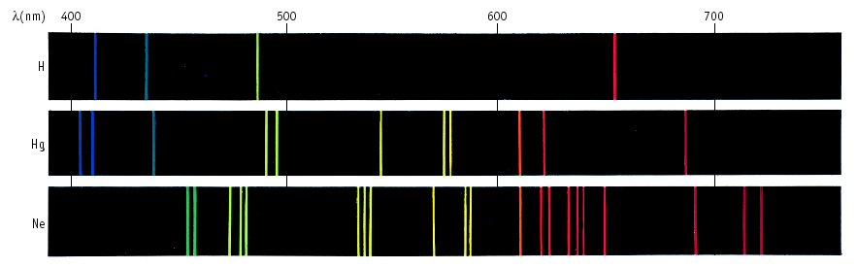
Line Spectra of Other Elements

Slide 15

The Electric Pickle
Excited atoms can emit light.
Here the solution in a pickle is excited electrically. The Na⁺ ions in the pickle juice give off light characteristic of that element.

Slide 16

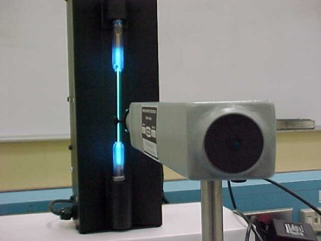
Light Spectrum Lab!
Slit that allows light inside
Line up the slit so that it is parallel with the spectrum tube (light bulb)
Scale

Slide 17

Light Spectrum Lab!
Slit that allows light inside
Scale
Run electricity through various gases, creating light
Look at the light using a spectroscope to separate the light into its component colors
Using colored pencils, draw the line spectra (all of the lines) and determine the wavelength of the three brightest lines
Once you line up the slit with the light, then look to the scale on the right. You should see the colored lines under the scale.
Eyepiece

Slide 18
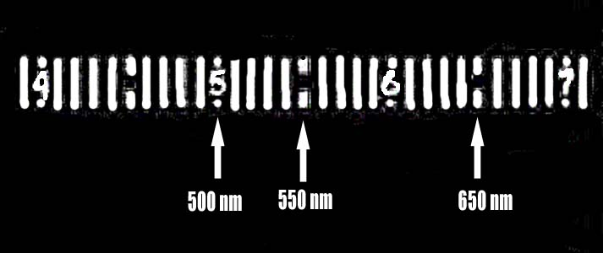
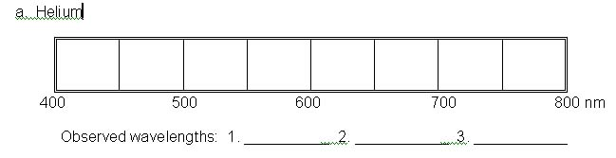
Light Spectrum Lab!

Slide 19
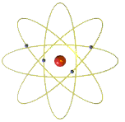
Atomic Spectra
One view of atomic structure in early 20th century was that an electron (e-) traveled about the nucleus in an orbit.

Slide 20
Atomic Spectra and Bohr
Bohr said classical view is wrong.
Need a new theory — now called QUANTUM or WAVE MECHANICS.
e- can only exist in certain discrete orbits
e- is restricted to QUANTIZED energy state (quanta = bundles of energy)

Slide 21
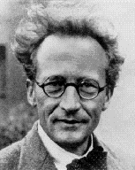
Quantum or Wave Mechanics
Schrodinger applied idea of e- behaving as a wave to the problem of electrons in atoms.
He developed the WAVE EQUATION
Solution gives set of math expressions called WAVE FUNCTIONS, Ψ
Each describes an allowed energy state of an e-
E. Schrodinger
1887-1961

Slide 22
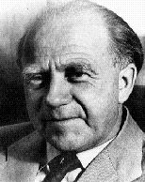
Heisenberg Uncertainty Principle
Problem of defining nature of electrons in atoms solved by W. Heisenberg.
Cannot simultaneously define the position and momentum (= m•v) of an electron.
We define e- energy exactly but accept limitation that we do not know exact position.
W. Heisenberg
1901-1976

Slide 23
Arrangement of Electrons in Atoms
Electrons in atoms are arranged as
LEVELS (n)
SUBLEVELS (l)
ORBITALS (m_{l})

Slide 24
QUANTUM NUMBERS
The shape, size, and energy of each orbital is a function of 3 quantum numbers which describe the location of an electron within an atom or ion
n (principal) ---> energy level
l (orbital) ---> shape of orbital
m_{l} (magnetic) ---> designates a particular suborbital
The fourth quantum number is not derived from the wave function
s (spin) ---> spin of the electron (clockwise or counterclockwise: ½ or – ½)

Slide 25
QUANTUM NUMBERS
So… if two electrons are in the same place at the same time, they must be repelling, so at least the spin quantum number is different!
The Pauli Exclusion Principle says that no two electrons within an atom (or ion) can have the same four quantum numbers.
If two electrons are in the same energy level, the same sublevel, and the same orbital, they must repel.
Think of the 4 quantum numbers as the address of an electron… Country > State > City > Street

Slide 26

Energy Levels
Each energy level has a number called the PRINCIPAL QUANTUM NUMBER, n
Currently n can be 1 thru 7, because there are 7 periods on the periodic table

Slide 27
Energy Levels
n = 1
n = 2
n = 3
n = 4

Slide 28
Relative sizes of the spherical 1s, 2s, and 3s orbitals of hydrogen.

Slide 29
Types of Orbitals
The most probable area to find these electrons takes on a shape
So far, we have 4 shapes. They are named s, p, d, and f.
No more than 2 e- assigned to an orbital – one spins clockwise, one spins counterclockwise

Slide 30
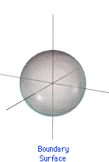
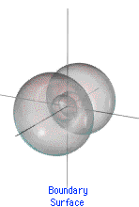
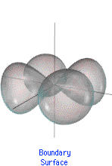
Types of Orbitals (l)
s orbital
p orbital
d orbital

Slide 31
p Orbitals
this is a p sublevel with 3 orbitals
These are called x, y, and z
There is a PLANAR NODE thru the nucleus, which is an area of zero probability of finding an electron
3p_{y} orbital

Slide 32
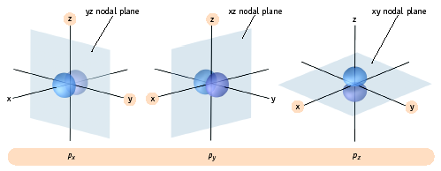
p Orbitals
The three p orbitals lie 90º apart in space

Slide 33
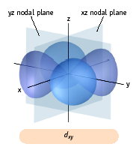
d Orbitals
d sublevel has 5 orbitals

Slide 34
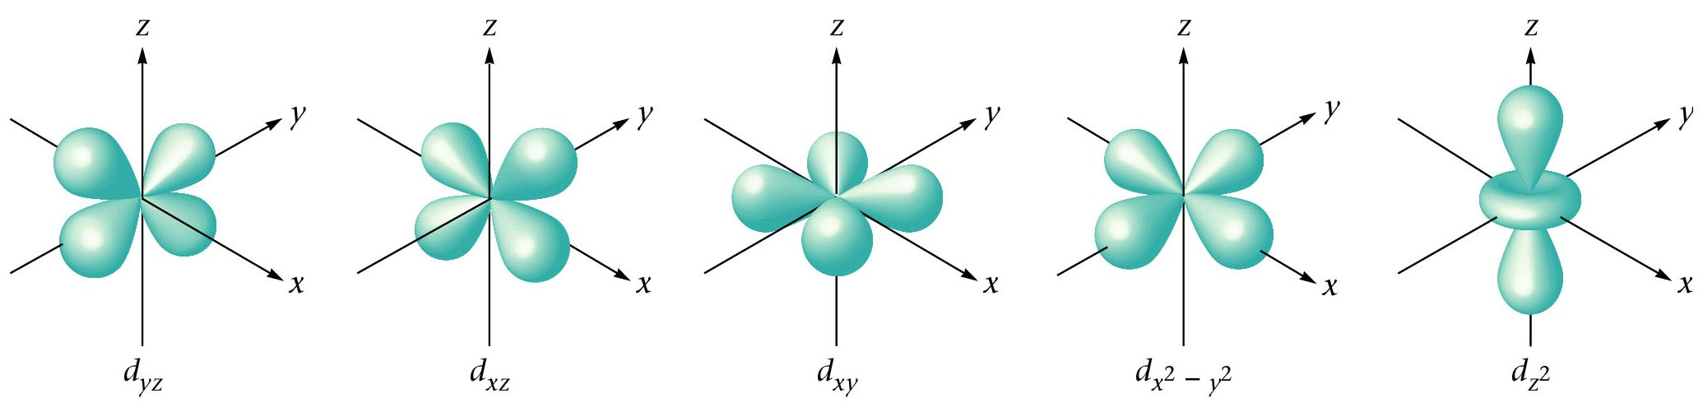
The shapes and labels of the five 3d orbitals.

Slide 35
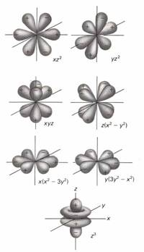
f Orbitals
For l = 3, ---> f sublevel with 7 orbitals

Slide 36
Diagonal Rule
Must be able to write it for the test! This will be question #1 ! Without it, you will not get correct answers !
The diagonal rule is a memory device that helps you remember the order of the filling of the orbitals from lowest energy to highest energy
_____________________ states that electrons fill from the lowest possible energy to the highest energy

Slide 37
Diagonal Rule
Steps:
Write the energy levels top to bottom.
Write the orbitals in s, p, d, f order. Write the same number of orbitals as the energy level.
Draw diagonal lines from the top right to the bottom left.
To get the correct order, follow the arrows!
1
2
3
4
5
6
7
s
s 2p
s 3p 3d
s 4p 4d 4f
By this point, we are past the current periodic table so we can stop.
s 5p 5d 5f 5g?
s 6p 6d 6f 6g? 6h?
s 7p 7d 7f 7g? 7h? 7i?

Slide 38
Why are d and f orbitals always in lower energy levels?
d and f orbitals require LARGE amounts of energy
It’s better (lower in energy) to skip a sublevel that requires a large amount of energy (d and f orbtials) for one in a higher level but lower energy
This is the reason for the diagonal rule! BE SURE TO FOLLOW THE ARROWS IN ORDER!

Slide 39
How many electrons can be in a sublevel?
Remember: A maximum of two electrons can be placed in an orbital.
s orbitals
p orbitals
d orbitals
f orbitals
Number of
orbitals
Number of electrons

Slide 40
Electron Configurations
A list of all the electrons in an atom (or ion)
Must go in order (Aufbau principle)
2 electrons per orbital, maximum
We need electron configurations so that we can determine the number of electrons in the outermost energy level. These are called valence electrons.
The number of valence electrons determines how many and what this atom (or ion) can bond to in order to make a molecule
1s² 2s² 2p⁶ 3s² 3p⁶ 4s² 3d¹⁰ 4p⁶ 5s² 4d¹⁰ 5p⁶ 6s² 4f¹⁴… etc.

Slide 41
Electron Configurations
2p⁴
Number of electrons in the sublevel
Energy Level
Sublevel
1s² 2s² 2p⁶ 3s² 3p⁶ 4s² 3d¹⁰ 4p⁶ 5s² 4d¹⁰ 5p⁶ 6s² 4f¹⁴… etc.

Slide 42
Let’s Try It!
Write the electron configuration for the following elements:
H
Li
N
Ne
K
Zn
Pb

Slide 43
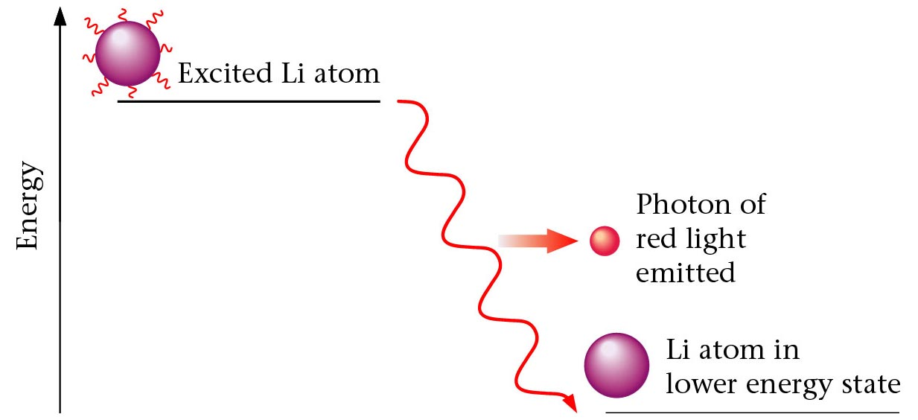
An excited lithium atom emitting a photon of red light to drop to a lower energy state.

Slide 44
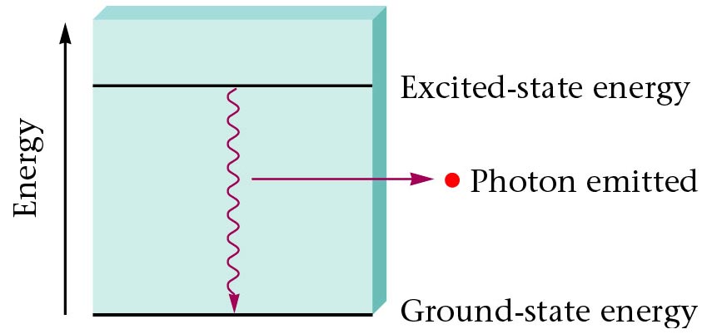
An excited H atom returns to a lower energy level.

Slide 45
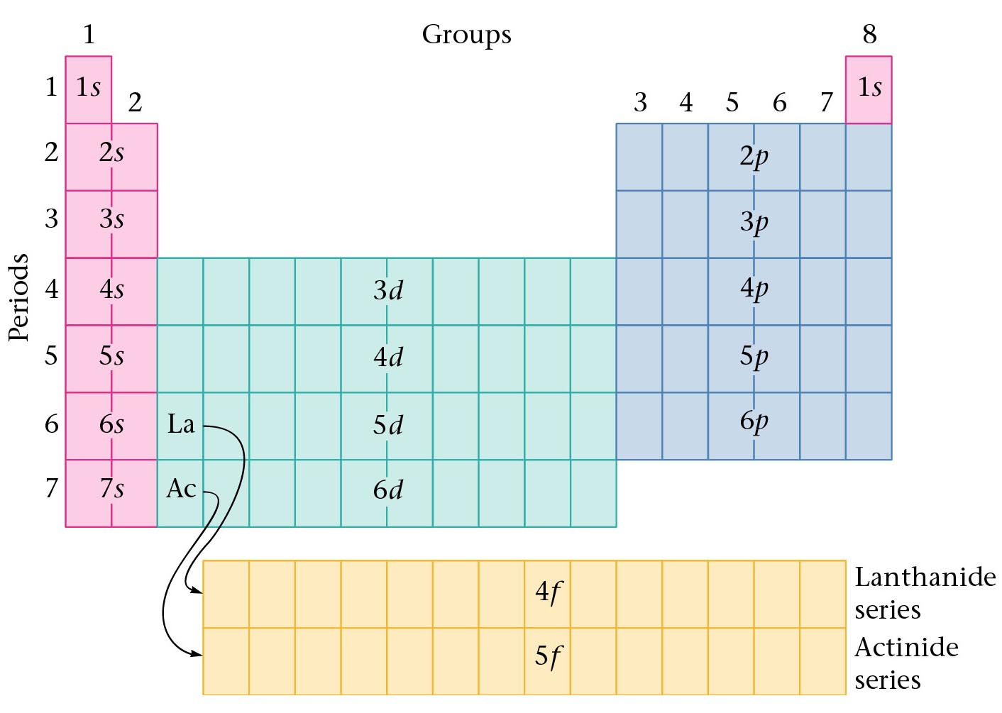
Orbitals and the Periodic Table
Orbitals grouped in s, p, d, and f orbitals (sharp, proximal, diffuse, and fundamental)
s orbitals
d orbitals
p orbitals
f orbitals

Slide 46
Shorthand Notation
A way of abbreviating long electron configurations
Since we are only concerned about the outermost electrons, we can skip to places we know are completely full (noble gases), and then finish the configuration

Slide 47
Shorthand Notation
Step 1: It’s the Showcase Showdown!
Find the closest noble gas to the atom (or ion), WITHOUT GOING OVER the number of electrons in the atom (or ion). Write the noble gas in brackets [ ].
Step 2: Find where to resume by finding the next energy level.
Step 3: Resume the configuration until it’s finished.

Slide 48
Shorthand Notation
Chlorine
Longhand is 1s² 2s² 2p⁶ 3s² 3p⁵
You can abbreviate the first 10 electrons with a noble gas, Neon. [Ne] replaces 1s² 2s² 2p⁶
The next energy level after Neon is 3
So you start at level 3 on the diagonal rule (all levels start with s) and finish the configuration by adding 7 more electrons to bring the total to 17
[Ne] 3s² 3p⁵

Slide 49
Practice Shorthand Notation
Write the shorthand notation for each of the following atoms:
Cl
K
Ca
I
Bi

Slide 50
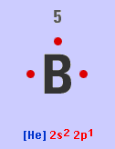
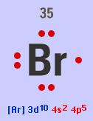
Valence Electrons
Electrons are divided between core and valence electrons
B 1s² 2s² 2p¹
Core = [He] , valence = 2s² 2p¹
Br [Ar] 3d¹⁰ 4s² 4p⁵
Core = [Ar] 3d¹⁰ , valence = 4s² 4p⁵

Slide 51
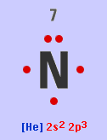
Rules of the Game
No. of valence electrons of a main group atom = Group number (for A groups)
Atoms like to either empty or fill their outermost level. Since the outer level contains two s electrons and six p electrons (d & f are always in lower levels), the optimum number of electrons is eight. This is called the octet rule.

Slide 52
Keep an Eye On Those Ions!
Electrons are lost or gained like they always are with ions… negative ions have gained electrons, positive ions have lost electrons
The electrons that are lost or gained should be added/removed from the highest energy level (not the highest orbital in energy!)

Slide 53
Keep an Eye On Those Ions!
Tin
Atom: [Kr] 5s² 4d¹⁰ 5p²
Sn⁺⁴ ion: [Kr] 4d¹⁰
Sn⁺² ion: [Kr] 5s² 4d¹⁰
Note that the electrons came out of the highest energy level, not the highest energy orbital!

Slide 54
Keep an Eye On Those Ions!
Bromine
Atom: [Ar] 4s² 3d¹⁰ 4p⁵
Br⁻ ion: [Ar] 4s² 3d¹⁰ 4p⁶
Note that the electrons went into the highest energy level, not the highest energy orbital!

Slide 55
Try Some Ions!
Write the longhand notation for these:
F⁻
Li⁺
Mg⁺²
Write the shorthand notation for these:
Br⁻
Ba⁺²
Al⁺³

Slide 56
Exceptions to the Aufbau Principle
(HONORS only)
Remember d and f orbitals require LARGE amounts of energy
If we can’t fill these sublevels, then the next best thing is to be HALF full (one electron in each orbital in the sublevel)
There are many exceptions, but the most common ones are
d⁴ and d⁹
For the purposes of this class, we are going to assume that ALL atoms (or ions) that end in d⁴ or d⁹ are exceptions to the rule. This may or may not be true, it just depends on the atom.

Slide 57
Exceptions to the Aufbau Principle
(HONORS only)
d⁴ is one electron short of being HALF full
In order to become more stable (require less energy), one of the closest s electrons will actually go into the d, making it d⁵ instead of d⁴.
For example: Cr would be [Ar] 4s² 3d⁴, but since this ends exactly with a d⁴ it is an exception to the rule. Thus, Cr should be [Ar] 4s¹ 3d⁵.
Procedure: Find the closest s orbital. Steal one electron from it, and add it to the d.

Slide 58
Exceptions to the Aufbau Principle
(HONORS only)
OK, so this helps the d, but what about the poor s orbital that loses an electron?
Remember, half full is good… and when an s loses 1, it too becomes half full!
So… having the s half full and the d half full is usually lower in energy than having the s full and the d to have one empty orbital.

Slide 59
Exceptions to the Aufbau Principle
(HONORS only)
d⁹ is one electron short of being full
Just like d⁴, one of the closest s electrons will go into the d, this time making it d¹⁰ instead of d⁹.
For example: Au would be [Xe] 6s² 4f¹⁴ 5d⁹, but since this ends exactly with a d⁹ it is an exception to the rule. Thus, Au should be [Xe] 6s¹ 4f¹⁴ 5d¹⁰.
Procedure: Same as before! Find the closest s orbital. Steal one electron from it, and add it to the d.

Slide 60
Try These!
(HONORS only)
Write the shorthand notation for:
Cu
W
Au

Slide 61
Orbital Diagrams
Graphical representation of an electron configuration
One arrow represents one electron
Shows spin and which orbital within a sublevel
Same rules as before (Aufbau principle, d⁴ and d⁹ exceptions, two electrons in each orbital, etc. etc.)

Slide 62
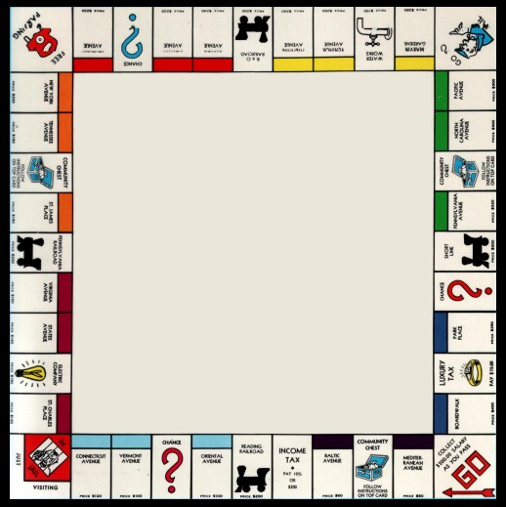


Orbital Diagrams
One additional rule: Hund’s Rule
In orbitals of EQUAL ENERGY (p, d, and f), place one electron in each orbital before making any pairs
All single electrons must spin the same way
I nickname this rule the “Monopoly Rule”
In Monopoly, you have to build houses EVENLY. You can not put 2 houses on a property until all the properties have at least 1 house.

Slide 63
Lithium
Group 1A
Atomic number = 3
1s²2s¹ ---> 3 total electrons

Slide 64
Carbon
Group 4A
Atomic number = 6
1s² 2s² 2p² --->
6 total electrons
Here we see for the first time HUND’S RULE. When placing electrons in a set of orbitals having the same energy, we place them singly as long as possible.

Slide 65
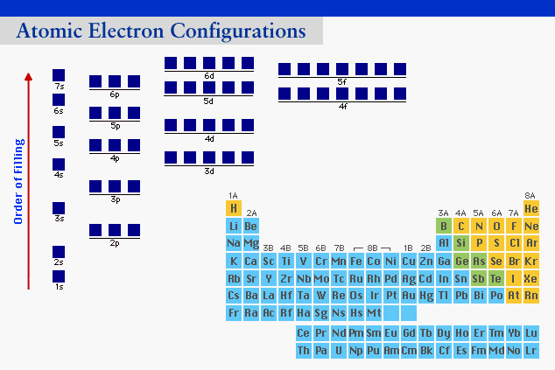
Lanthanide Element Configurations
4f orbitals used for Ce - Lu and 5f for Th - Lr

Slide 66
Draw these orbital diagrams!
Oxygen (O)
Chromium (Cr)
Mercury (Hg)

Slide 67
Ion Configurations
To form anions from elements, add 1 or more e- from the highest sublevel.
P [Ne] 3s² 3p³ + 3e- ---> P³⁻ [Ne] 3s² 3p⁶ or [Ar]

Slide 68
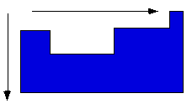
General Periodic Trends
Atomic and ionic size
Ionization energy
Electronegativity
Higher effective nuclear charge
Electrons held more tightly
Larger orbitals.
Electrons held less
tightly.

Slide 69
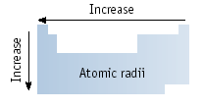
Atomic Size
Size goes UP on going down a group.
Because electrons are added further from the nucleus, there is less attraction. This is due to additional energy levels and the shielding effect. Each additional energy level “shields” the electrons from being pulled in toward the nucleus.
Size goes DOWN on going across a period.

Slide 70
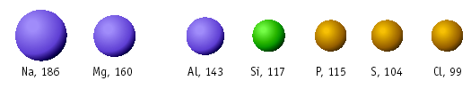
Atomic Size
Size decreases across a period owing to increase in the positive charge from the protons. Each added electron feels a greater and greater + charge because the protons are pulling in the same direction, where the electrons are scattered.
Large
Small

Slide 71
Which is Bigger?
Na or K ?
Na or Mg ?
Al or I ?

Slide 72
Ion Sizes
Does the size go
up or down when losing an electron to form a cation?

Slide 73
Ion Sizes
+
Forming a cation.
Li,152 pm
Li
+
, 78 pm
3e and 3p
2e and 3 p
CATIONS are SMALLER than the atoms from which they come.
The electron/proton attraction has gone UP and so size DECREASES.

Slide 74
Ion Sizes
Does the size go up or down when gaining an electron to form an anion?

Slide 75
Ion Sizes
-
Forming an anion.
F, 71 pm
-
F
, 133 pm
9e and 9p
10 e and 9 p
ANIONS are LARGER than the atoms from which they come.
The electron/proton attraction has gone DOWN and so size INCREASES.
Trends in ion sizes are the same as atom sizes.

Slide 76
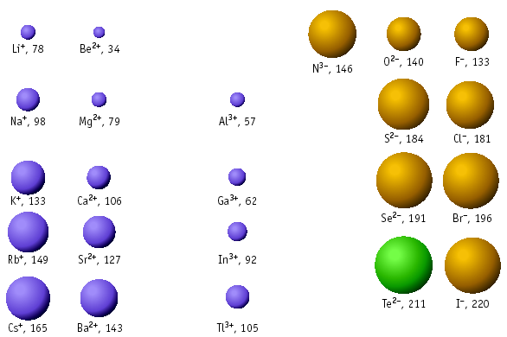
Trends in Ion Sizes
Figure 8.13

Slide 77

Which is Bigger?
Cl or Cl⁻ ?
K⁺ or K ?
Ca or Ca⁺² ?
I⁻ or Br⁻ ?

Slide 78
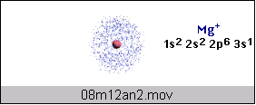
Ionization Energy
IE = energy required to remove an electron from an atom (in the gas phase).
Mg (g) + 738 kJ ---> Mg⁺ (g) + e-
This is called the FIRST ionization energy because we removed only the OUTERMOST electron
Mg⁺ (g) + 1451 kJ ---> Mg²⁺ (g) + e-
This is the SECOND IE.

Slide 79
Trends in Ionization Energy
IE increases across a period because the positive charge increases.
Metals lose electrons more easily than nonmetals.
Nonmetals lose electrons with difficulty (they like to GAIN electrons).

Slide 80
Trends in Ionization Energy
IE increases UP a group
Because size increases (Shielding Effect)

Slide 81
Which has a higher 1st ionization energy?
Mg or Ca ?
Al or S ?
Cs or Ba ?

Slide 82
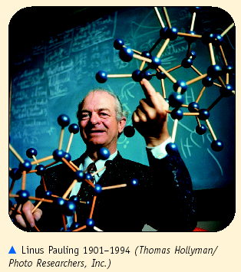
Electronegativity, χ
χ is a measure of the ability of an atom in a molecule to attract electrons to itself.
Concept proposed by
Linus Pauling
1901-1994

Slide 83
Periodic Trends: Electronegativity
In a group: Atoms with fewer energy levels can attract electrons better (less shielding). So, electronegativity increases UP a group of elements.
In a period: More protons, while the energy levels are the same, means atoms can better attract electrons. So, electronegativity increases RIGHT in a period of elements.

Slide 84
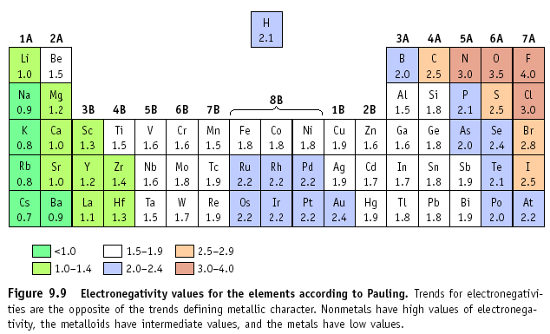
Electronegativity

Slide 85
Which is more electronegative?
F or Cl ?
Na or K ?
Sn or I ?

Slide 86

The End !!!!!!!!!!!!!!!!!!!

